Slide 1

Title
Prediction of structure, finding critical residue and interacting sites of
antitoxin toxin pairs of Neisseria Lactamica , and study dynamics of
proteins using Molecular Dynamics Simulation

Slide 2
Aim
Structure Prediction of unknown antitoxin-toxin pair
Critical Residues of the unknown toxin-antitoxin pair
Interacting Sites of the unknown toxin-antitoxin pair
Using Molecular Dynamics Simulations study the aforementioned proteins
The toxin - antitoxin pair of Neisseria lactamica were chosen.

Slide 3
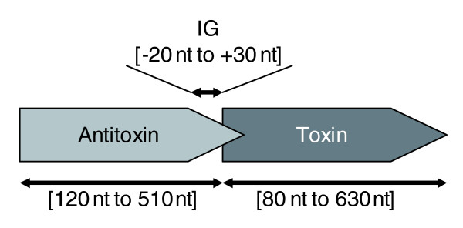
Introduction : Toxin - Antitoxin system
A toxin-antitoxin system is a set of two or more closely linked genes that together encode both a protein 'poison' and a corresponding 'antidote'.
Toxin-antitoxin systems are typically classified according to how the antitoxin neutralises the toxin.
The protein toxin in a type II system is inhibited post-translationally by the binding of another protein antitoxin.
Reference : https://en.wikipedia.org/wiki/Toxin-antitoxin_system

Slide 4
Sequence Similarity
1.Blastp is performed for X(antitoxin) and Y(toxin) and we get FitA and FitB.
2.FitA and FitB are selected such that they have <90% similarity respectively.
3.Structures of X and Y are unavailable on RCSB PDB but of FitA and FitB are available.

Slide 5
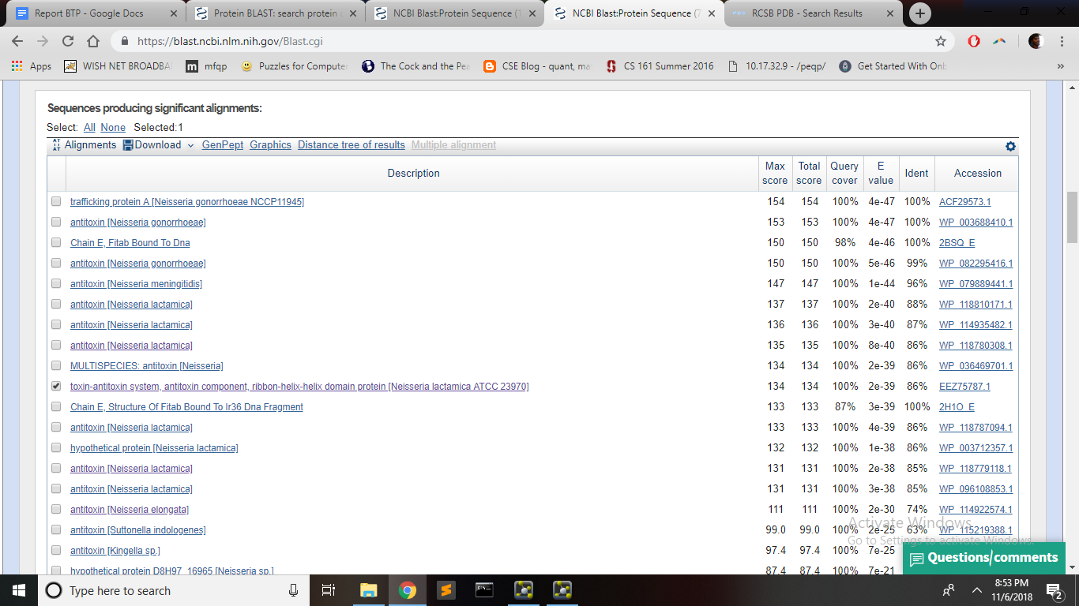

Slide 6
Homology Modelling
1. Homology modeling, also known as comparative modeling of protein, refers to constructing an atomic-resolution model of the "target" protein from its amino acid sequence and an experimental three-dimensional structure of a related homologous protein (the "template").
2. Homology modeling relies on the identification of one or more known protein structures likely to resemble the structure of the query sequence, and on the production of an alignment that maps residues in the query sequence to residues in the template sequence has been shown that protein structures are more conserved than protein sequences amongst homologues, but sequences falling below a 20% sequence identity can have very different structure.
In this case we use SWISS-MODEL (https://swissmodel.expasy.org/) for Homology Modelling. It uses a target sequence (X and Y FASTA sequences in this case) to build a model on a known template.

Slide 7
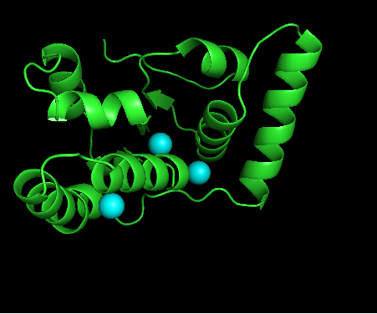
After Prediction : -
Antitoxin (X) with water molecules

Slide 8
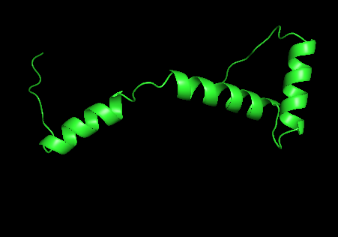
Toxin (Y)

Slide 9
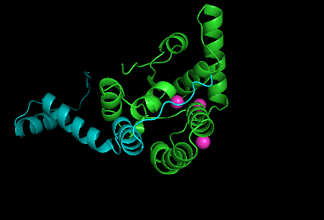
AntiToxin - Toxin after Docking via PatchDock

Slide 10
Theory regarding Molecular Dynamics
Molecular Dynamics simulations can be used in determining where drug molecules bind, and how they exert their effects. We used simulations to determine where this molecule binds to its receptor, and how it changes the binding strength of molecules that bind elsewhere (in part by changing the protein’s structure). We then used that information to alter the molecule such that it has a different effect. Determining functional mechanisms of proteins. Molecular Dynamics Simulations can be used to describe the mechanism by which drugs binding to one end of the receptor cause the other end of the receptor to change shape (activate). It can be used for studying protein folding.Molecular dynamics simulations permit the study of complex, dynamic processes that occur in biological systems.

Slide 11
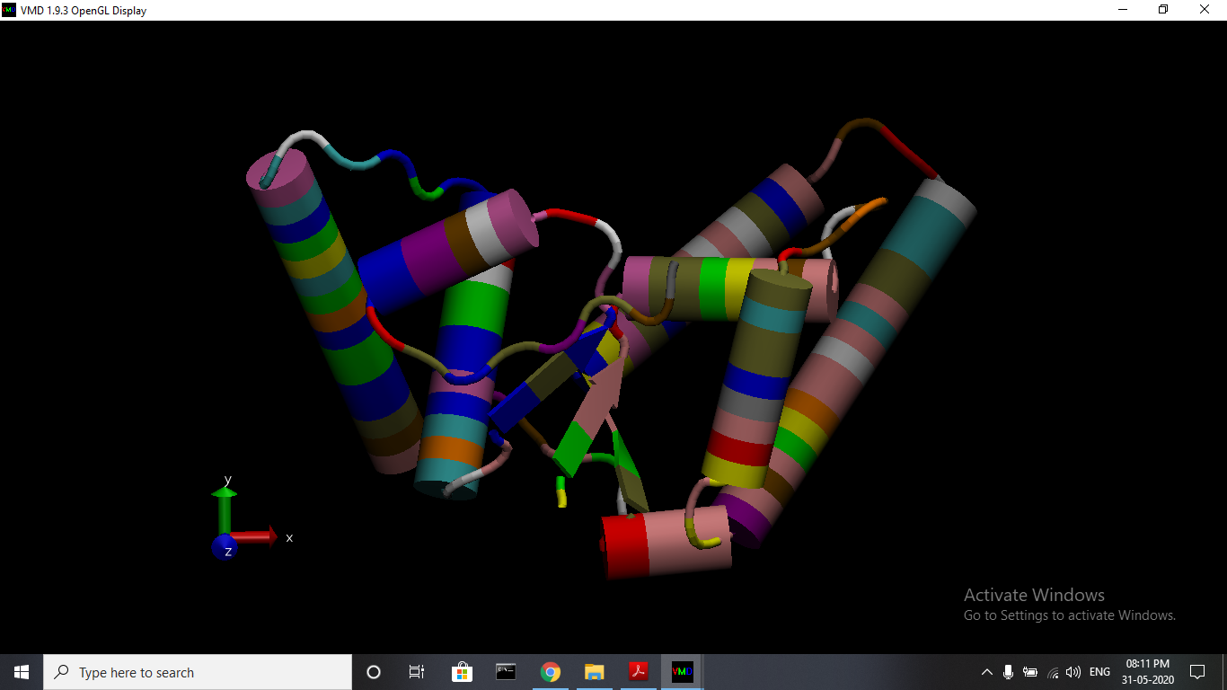
Antitoxin in VMD

Slide 12
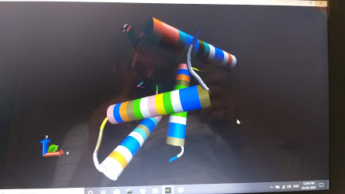
Toxin in VMD

Slide 13
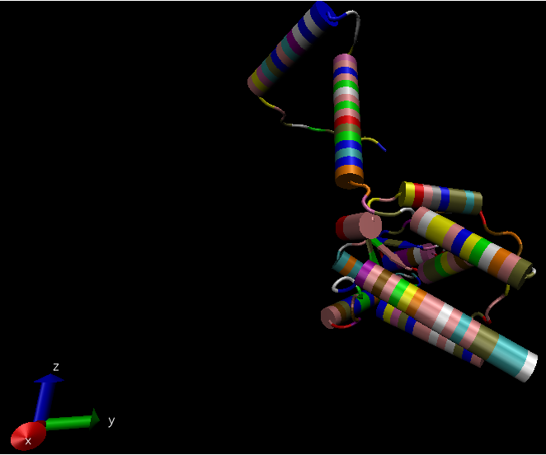
Resultant Complex made using VMD

Slide 14
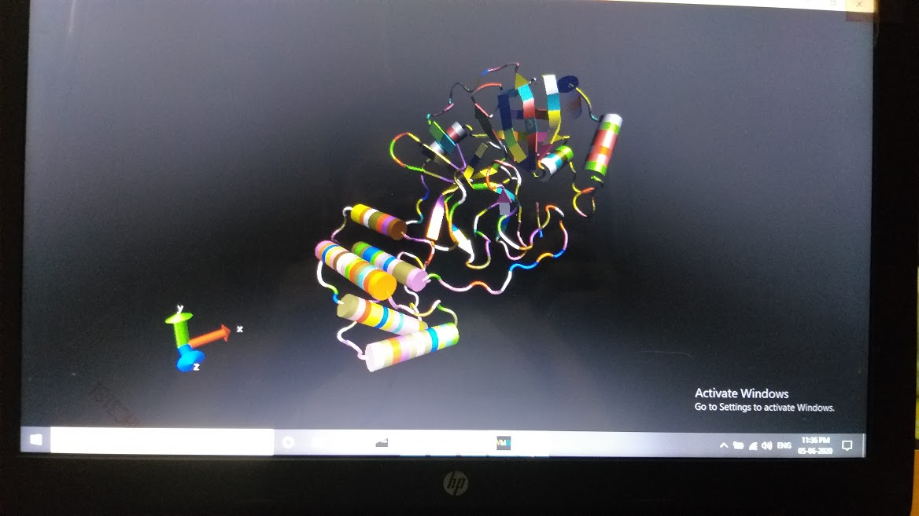
SARS COV 2 protein using VMD

Slide 15
Vaccine for SARS COV2 using Molecular Dynamics
Using some particular characteristics of the structure of protein in SARS COV2, one can come up with designing inhibitor or vaccine. The protein needs to go through preparation, minimization and equilibration and we can then study using solvation.
We can run that simulation at different temperature and find the RMSD value.

Slide 16
Analysis
I used CLUSTALW to find conserved regions among different strains of bacteria using the ones with Neisseria Lactamica.
We find the interacting residues by finding their interacting distance to be less than 4.5 Armstrong.
We then use CLUSTERW analysis to find conserved regions.

Slide 17
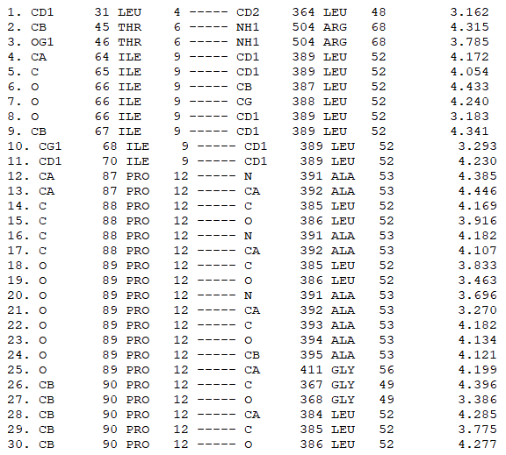
A small sampling from a C program to find interactions less than 4.5 Armstrongs
Total interactions found =414

Slide 18
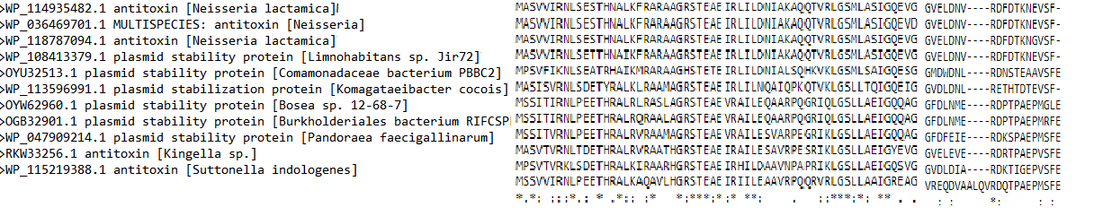
CLUSTERW Analysis

Slide 19
Critical Residues
For X(Antitoxin) residues 9,13,25,27,28,29,31,49,50,and 55 were found to be critical.
For Y(toxin) residues 43,44,46,47,48,53,55,56,61,63,64,67,68 were found to be critical.

Slide 20
Molecular Dynamics Simulation of Proteins
With the help of NAMD and VMD software we are able to visualize molecules better. After preparation minimization and solvation we were able to reach the last step of simulation.
However during running the simulation we faced a lot of problems. Energy after every step of simulation was increasing for the complex which led to Constraint Failure in RATTLE Algorithm.
Even after changing time step and increasing the size of water box we were unable to run the simulation on my personal computer.
Hence this report reflects my work but I do not have RMSD statistics associated with the toxin, antitoxin and the complex as I had hoped.

Slide 21
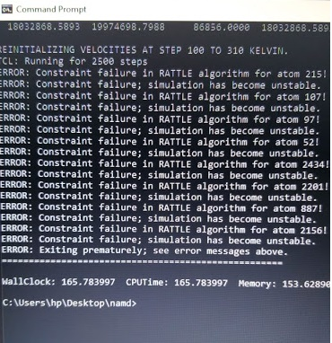
Simulation Failure due to bad Energy Minimization

Slide 22
FUTURE SCOPE
Most of the work done by me was computational in nature. Hence it has to be verified by experimentation. Only then can we surely say how the antitoxin - toxin pair looks like and what their interacting residues are.
Hence experimentation is something that must be done in future so as to verify our findings.
Using NAMD we can learn more on
Protein stability
● Conformational changes
● Protein folding
● Molecular recognition: proteins, DNA, membranes, complexes
● Ion transport in biological systems
and provide the mean to carry out the following studies,
● Drug Design
● Structure determination

Slide 23
Thank
You

